Slide 1
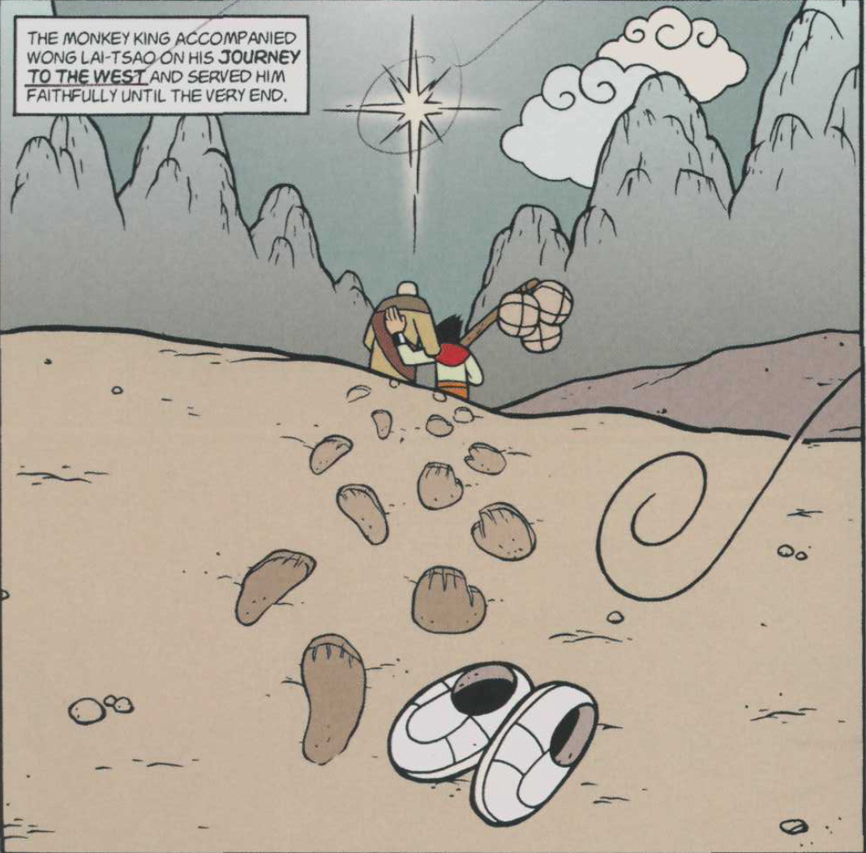
For next week:
By Monday read:
“Let’s Cook Thai: Recipes for Colonialism,” Heldke “Introduction: Empires of the Mind: My love affair with Asian food begins,” Shaw “Not from the Food,” Wong
To think about: Does Heldke’s interest in cooking Thai cuisine make her a “food colonizer” (398)? by Wed. read: “Beefeaters,” Sekhon “Toll House Cookies,” Nguyen “If You Are What You Eat, Then What Am I?,” Kothari “The Garden,” Noukou Thao
View media: Bao, Shi

Slide 2

CHATGpt: Explain in Gene Yang's American Born Chinese how performance works.
In Gene Luen Yang's graphic novel "American Born Chinese," the concept of performance is a central theme that explores how individuals sometimes feel the need to present themselves in certain ways to fit in or gain acceptance. The book follows three interconnected storylines, one of which involves Jin Wang, a Chinese-American boy. Jin struggles with his identity and tries to conform to American culture by changing his appearance and behavior. . . .As the story unfolds, Jin learns the importance of accepting his true self and embracing his cultural background, ultimately breaking free from the confines of the performance he had been putting on. This theme of performance highlights the challenges faced by individuals navigating cultural identity and the pressure to conform to societal norms.

Slide 3
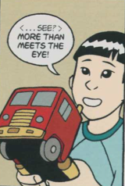
Today:
1.
How can ABC help us unpack the association between who we are and how we appear to others?
What is “us” and what is a (expected, coerced, conditioned) performance of an identity
2. What are the (unintended) consequences of using an animal analogy to talk about race in the U.S.?
3. Connect 1 &2
Related:
4. . Does this text “appropriate” a Buddhist tale in order to advance Christianity?

Slide 4
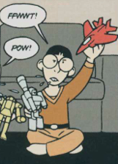
Does American Born Chinese validate the notion of one’s “true form” or does the inscription of multiple forms of impersonation, transformation, translation, duplication, revision, modification, role playing, mimicry, masking, performance, artifice, ventriloquism, drag, adaptation, or pretending play with notions of the authentic? What might be the significance of layering so many examples of imposture within one text? Do they work against its overt message?
I am not the real Gene Yang

Slide 5
Complication:
Is who we are the same as how we appear to others?
How is identity indistinguishable from the performance of identity?

Slide 6
How is the Monkey’s tale put into the service of ABC’s message to young people in the U.S.?
ABC, p. 160

Slide 7
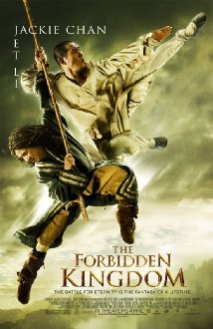
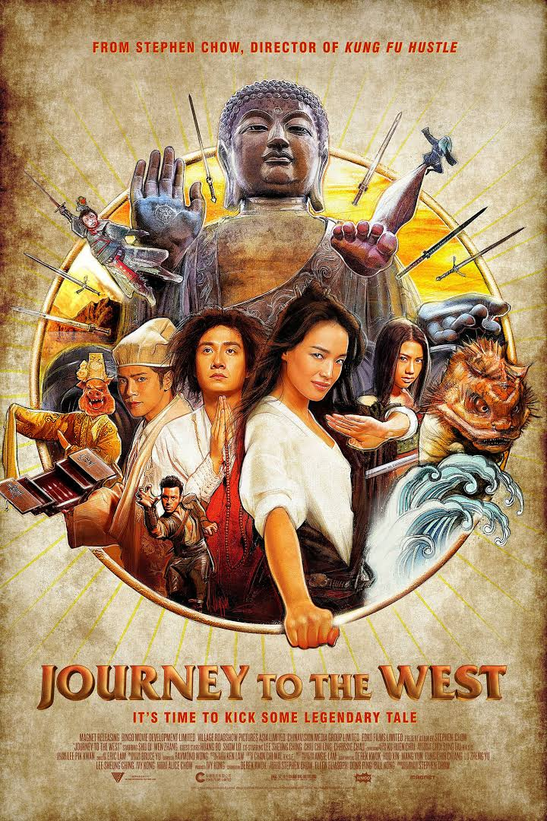
recent film adaptations, Journey to the West
The Forbidden Kingdom, 2008
Journey to the West, 2013

Slide 8
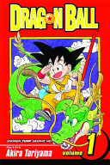
manga:
Dragon Ball
Akira Toriyama,
42 volumes: 1984 to 1995

Slide 9
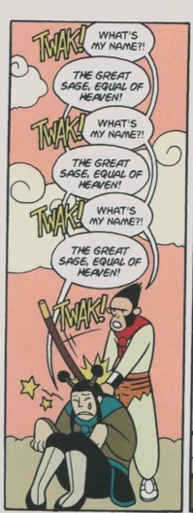
from Journey to the West
Buddha of the Western Paradise on the Monkey’s comparing himself to the Jade Emperor:
“How can you, an animal, who have only in this incarnation received half-human form, dare to make such a boast? You exceed yourself and will surely come to a bad end. Submit at once and talk no more of your nonsense.”

Slide 10
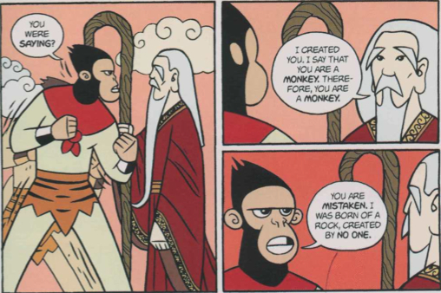
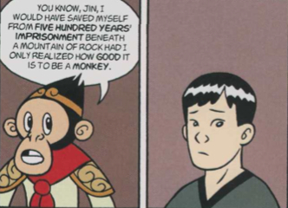
“monkeyness” as essential, a series of fixed traits?
Conflict: rebellion
Resolution: “how good it is to be a monkey”

Slide 11
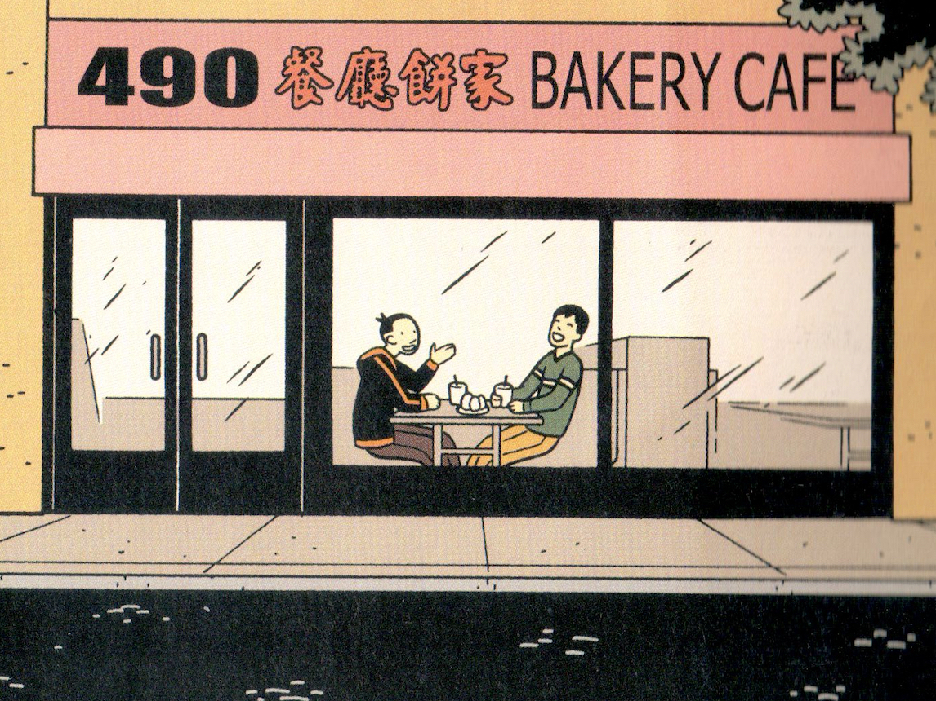

Slide 12
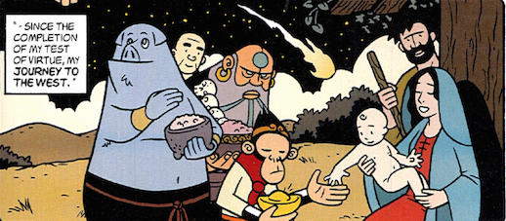
“I wanted to do an Asian-American retelling of the tale, so I added Western, Judeo-Christian elements to my version.” “Christianity, you see, lies at the very center of my identity as an Asian-American.” -- Gene Yang
"How would you feel if someone took one of your [Christian] stories and made it Taoist or Muslim or atheist?"
--graphic novelist Derek Kirk Kim

Slide 13
In retelling Journey, Yang refigures a Buddhist-Taoist tale in favor of Christian cosmology.
Is this an example of cultural fusion?
When is revision or adaptation a form of appropriation?

Slide 14
“As a psychoanalyst, I should help my patient to become conscious of his unconscious and abandon his attempts at hallucinatory whitening but also to act in the direction of a change in the social structure.” –Franz Fanon, Black Skin, White Masks

Slide 15
Biblical references in ABC
1. Visual of the Emissaries, p. 139
Ezekiel 1:10
10 As for the likeness of their faces, they four had the face of a man, and the face of a lion, on the right side: and they four had the face of an ox on the left side; they four also had the face of an eagle.
2. Tze-Yo-Tzhu p. 79- 80
Psalm 139 New King James Version, God’s Perfect Knowledge of Man
139: 7-10
⁷ Where can I go from Your Spirit? Or where can I flee from Your presence? ⁸ If I ascend into heaven, You are there; If I make my bed in hell, behold, You are there. ⁹ If I take the wings of the morning, And dwell in the uttermost parts of the sea, ¹⁰ Even there Your hand shall lead me, And Your right hand shall hold me.

Slide 16
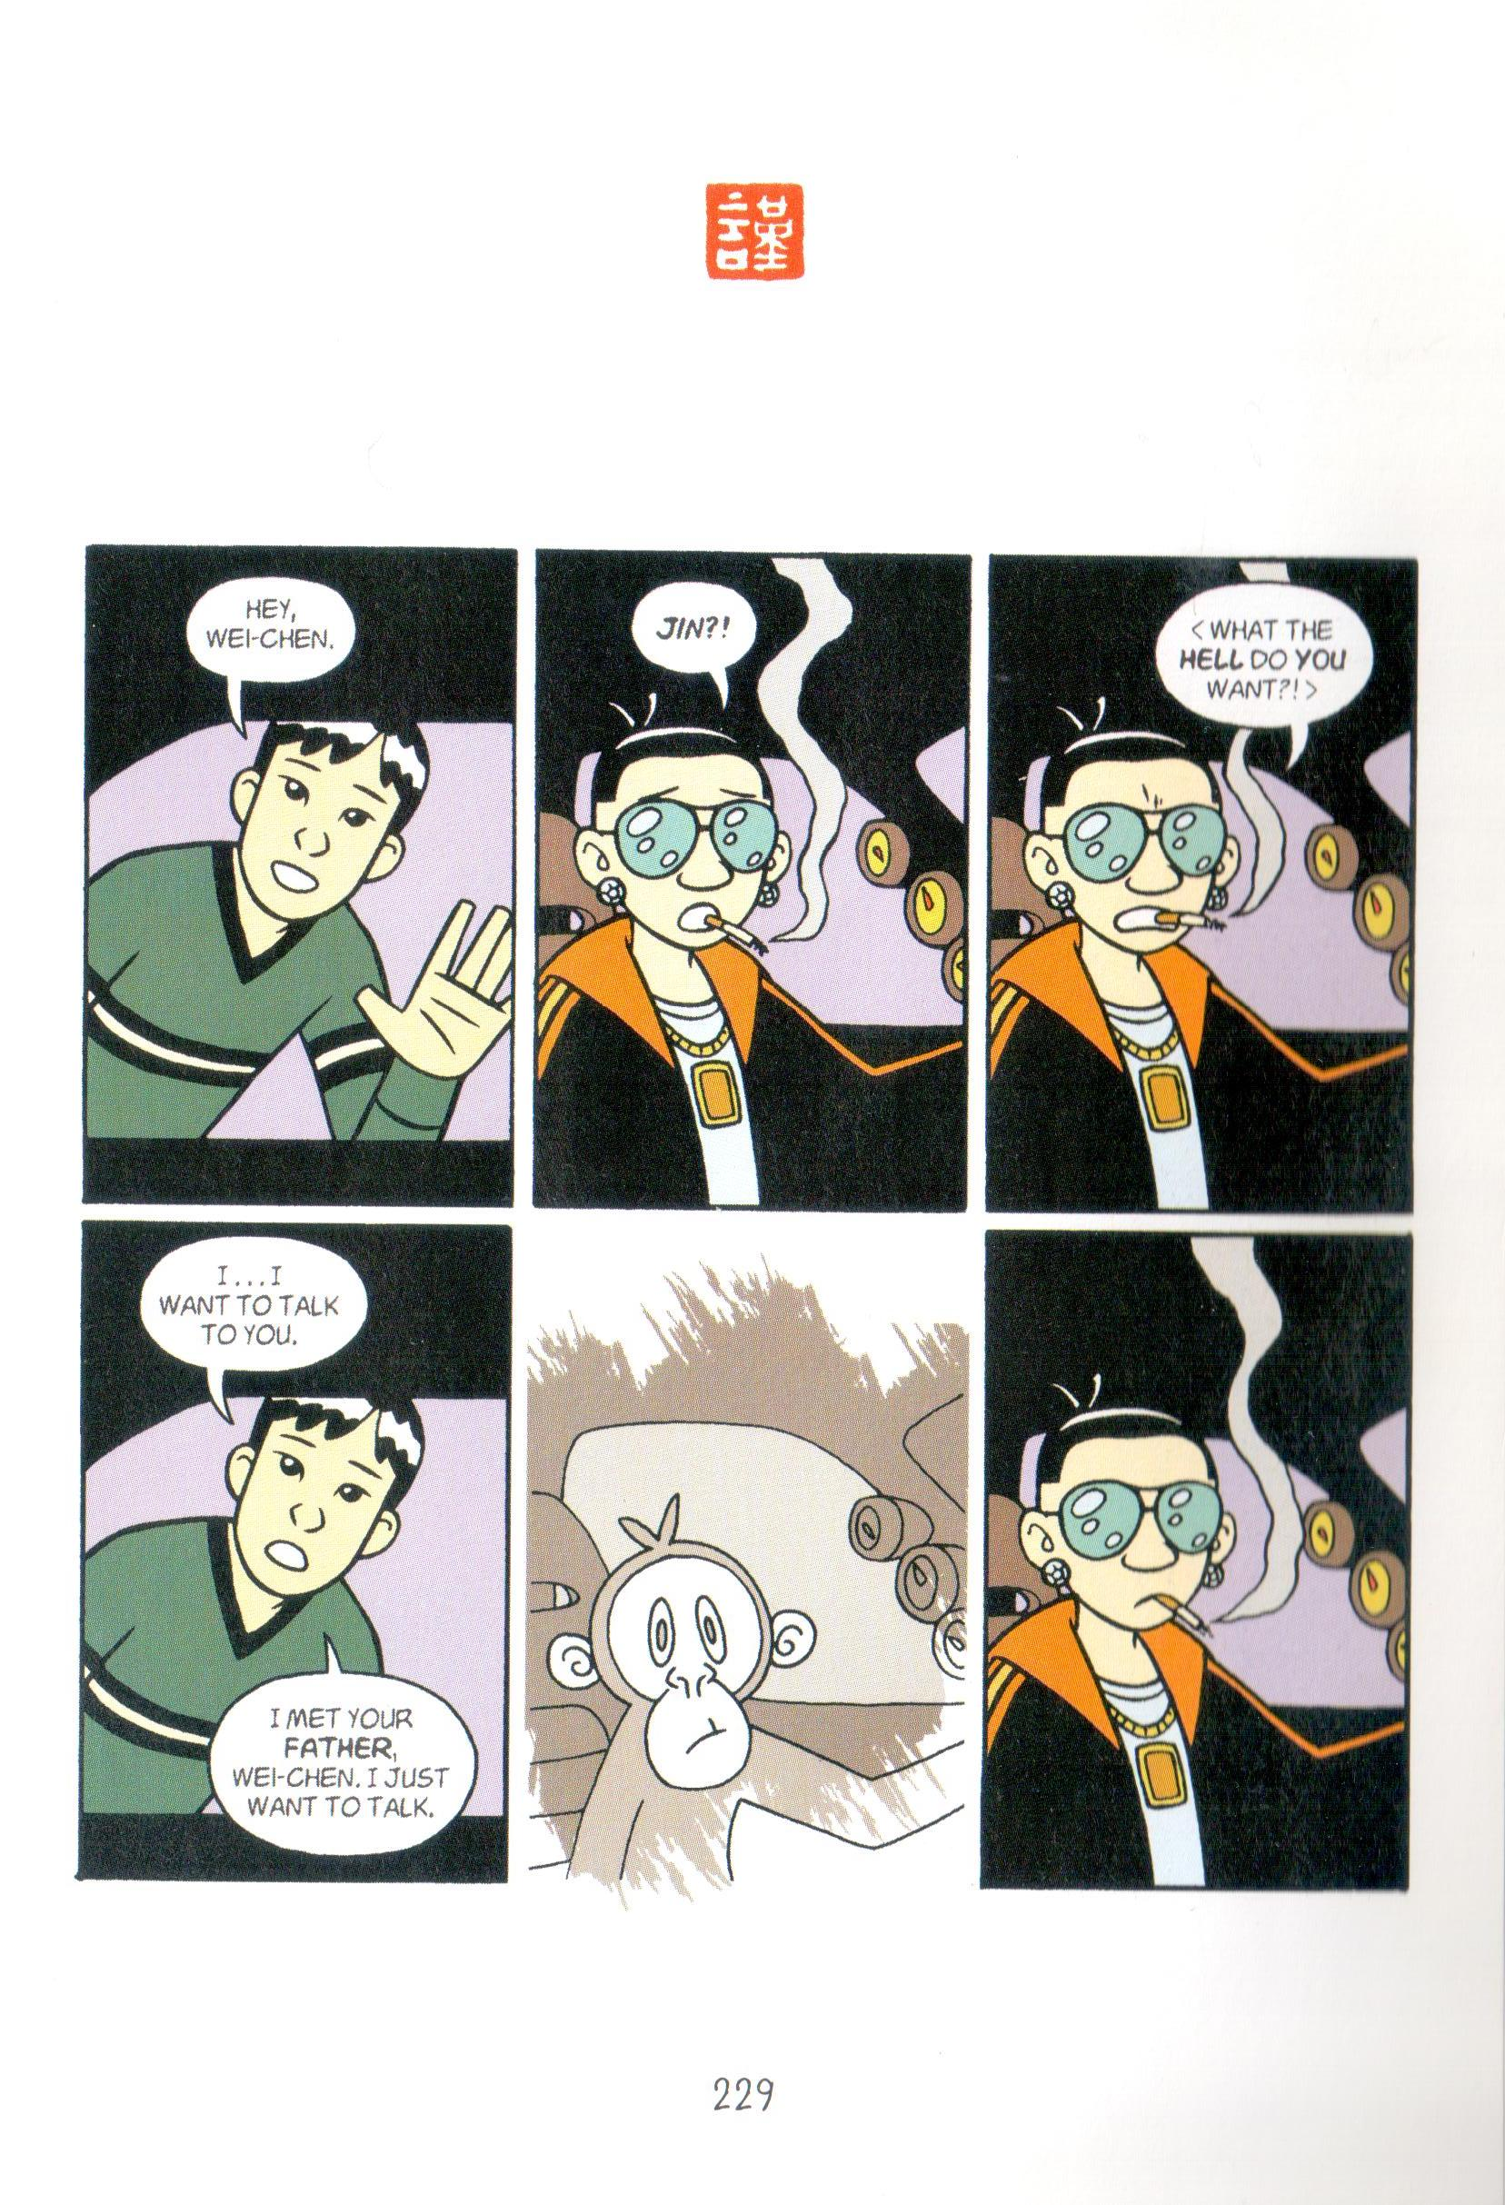

Slide 17
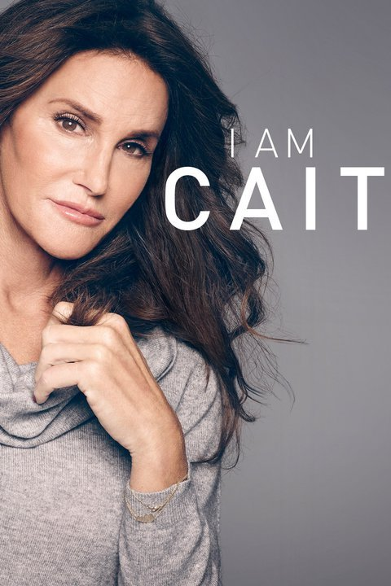
Transgender activist Caitlyn Jenner, formerly Bruce, 2015: on reconciling her interiority and selfhood with what is seen on the surface: “Bruce always had to tell a lie, he was always living that lie, every day, he always had a secret from morning till night. Caitlyn doesn’t have any secrets.”
“Change!”

Slide 18
philosopher Judith Butler on gender performativity:
“There is no gender identity behind the expressions of gender; that identity is performatively constituted by the very ‘expressions’ that are said to be its results. (Gender Trouble, 25 emphasis mine).
And
“Identifying with a gender under contemporary regimes of power involves identifying with a set of norms that are and are not realizable, and whose power and status precede the identifications by which they are insistently approximated. This “being a man” and this “being a woman” are internally unstable affairs [as] the forcible approximation of a norm one never chooses” (Bodies that Matter, 126)

Slide 19
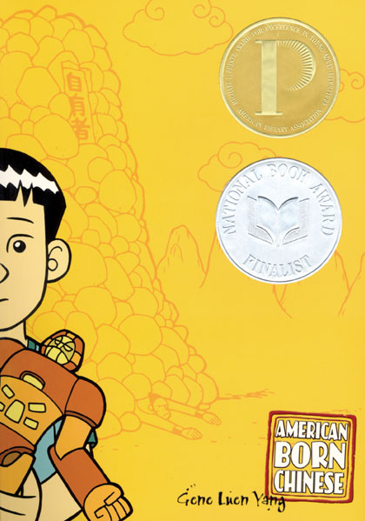
To think about:
How do you perform your own identity into being?
Is the performance your choice, coerced, or conditioned by social norms?

